Slide 1
OpenVPN Connect via RUT200 Modem to DX
Stafford Ho

Slide 2
RUT200 Modem Login 192.168.250.1
Username: admin
Password: Omron1234@
WIFI SSID: RUT200_54B4
WIFI Password: Ub3e7B0F
These can be found on the physical modem

Slide 3
Open Device Profile
Login to CloudConexxa/ OpenVPN Connect with
  Username: samuel-wen.lee@omron.com
  Password: Omron1234@
Create a new account and add into CloudConnexa
  CloudConnexa

Slide 4
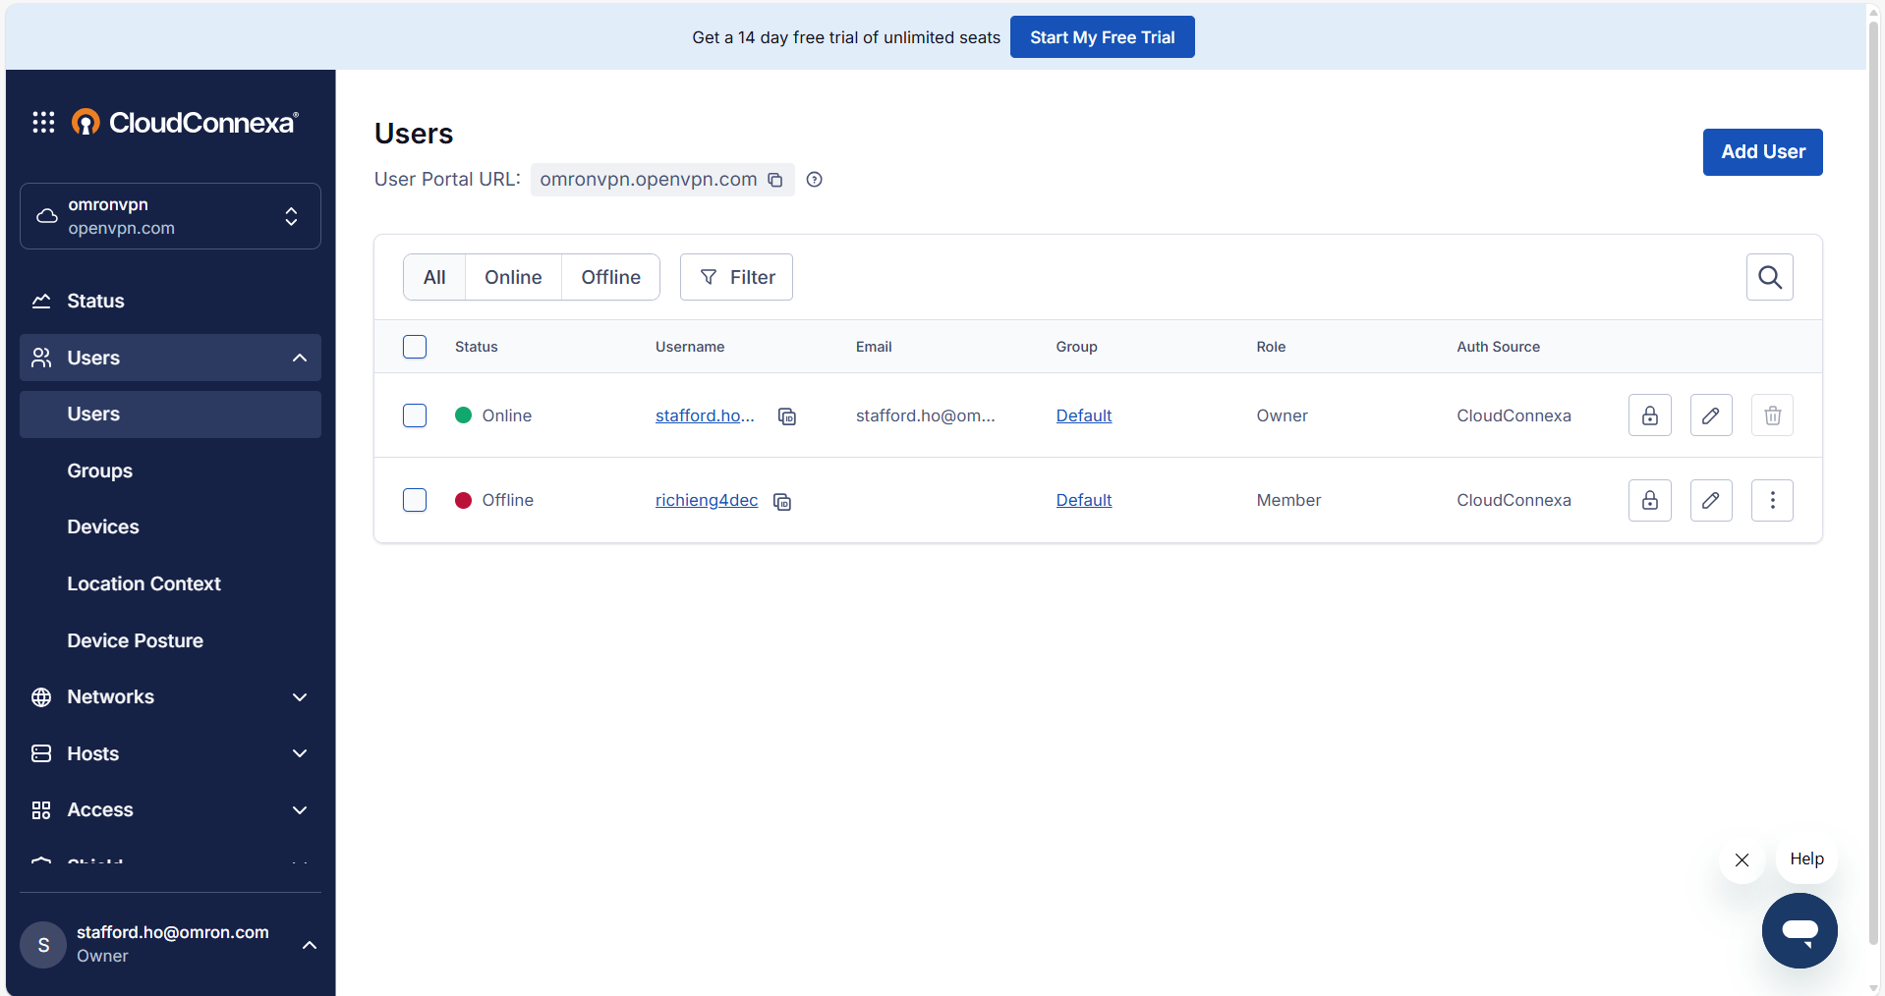
After Creating a new account, Add User under your account
Delete other users that are not in use as there is a limitation on the number of users that can be registered.

Slide 5
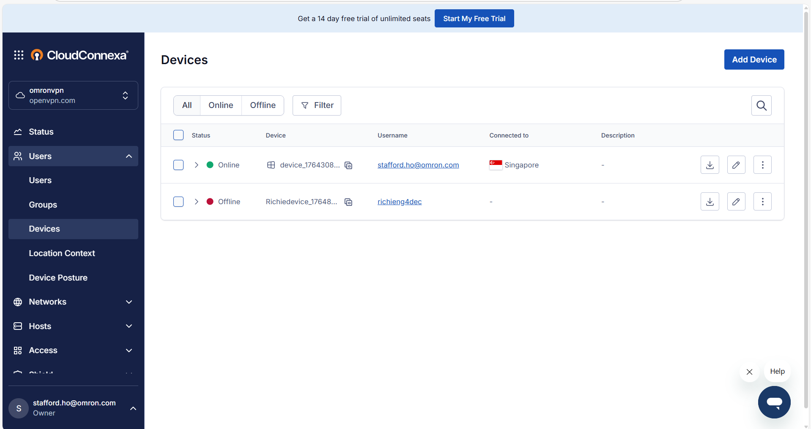
After adding a new User, Add Device under your User
Delete other Devices that are not in use as there is a limitation on the number of devices that can be registered.
When created, download profile and follow slide 2

Slide 6
Configuring PLC Default Gateway via Ethernet
Connect PC to PLC via ethernet Port 1 (as Port 2 is 192.168.251.xxx)
Set PC ethernet as 192.168.250.xxx (Don’t set the same as the PLC/ Modem as they will clash)
Ping IP from PC to confirm that connection is established
SSH into root@192.168.250.xxx (PLC IP Address)
  ip route del default
  ip route add default via 192.168.250.1 dev eth0

Slide 7
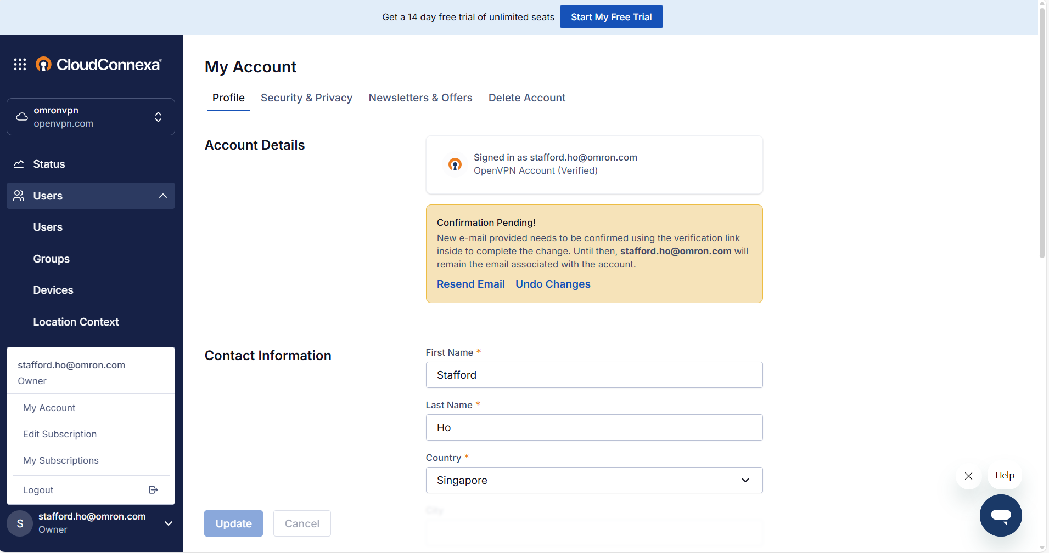
Changing Email Ownership
3. Change Email Ownership
4. Enter and await confirmation of email change
2. Click to open My Account page
1. Click to open settings branch

Slide 8
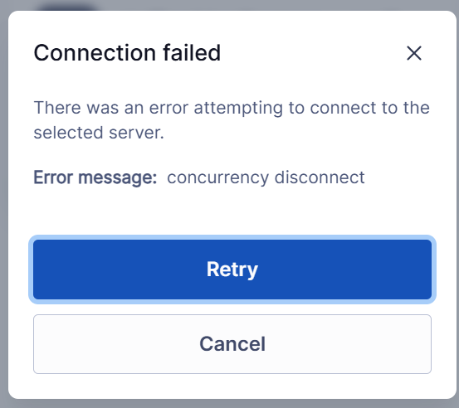
Take Note: Only one user may be logged in at a time
If you see “Error message: concurrency disconnect”, it means someone else has logged in via the same user profile.

